Slide 1
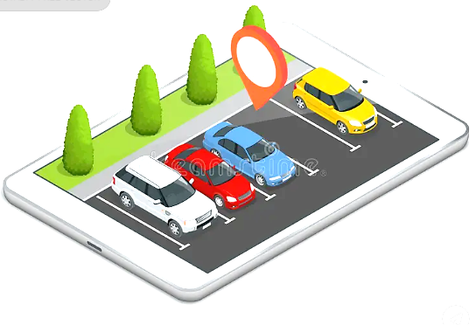
Smart Car Parking System
Automated Detection with Button Confirmation and Time-Limit Alert
PATRICK Twinamatsiko | VU-BSF-2311-0581-WEE
Robin Percy MUGUNDHO | VU-BSF-2311-0816-WEE
Derrick AGABA | VU-BSF-2403-1356-EVE
10-FEBRAURY-2026

Slide 2
Overview
What we’ll cover:
Problem & Objectives
System Components
How It Works (Flow)
Circuit & Code Highlights
Demonstration
Conclusion & Future Work plan
Goal: Show a working single-slot smart parking prototype using Arduino

Slide 3
Problem Statement And Objectives
Problem
Urban parking chaos time wasted searching, overstaying, inefficient use
Objectives
Auto-detect vehicle with ultrasonic sensor
Require button press to confirm and start timer.
Display status + timer on LCD
Alert (LED + buzzer) if time exceeds limit (demo: 10s)
Allow checkout & handle car leaving without button
Benefits: Low-cost, user-intent focused, educational prototype

Slide 4
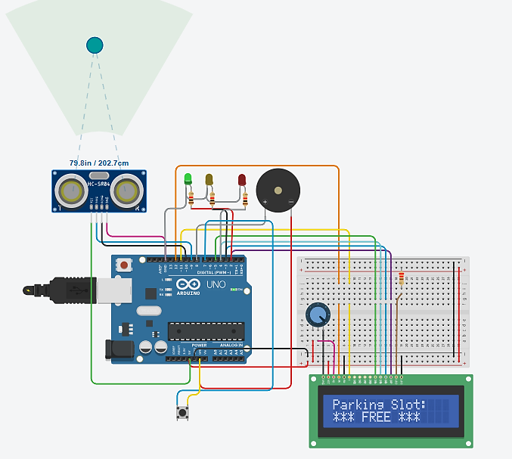
System Components
Hardware
Arduino UNO (brain)
HC-SR04 Ultrasonic Sensor (distance detection)
16×2 LCD (status messages)
Push Button (confirmation/checkout)
LEDs: Green (free), Yellow (alert), Red (occupied)
Buzzer (beeps & alerts)
Breadboard + wires

Slide 5
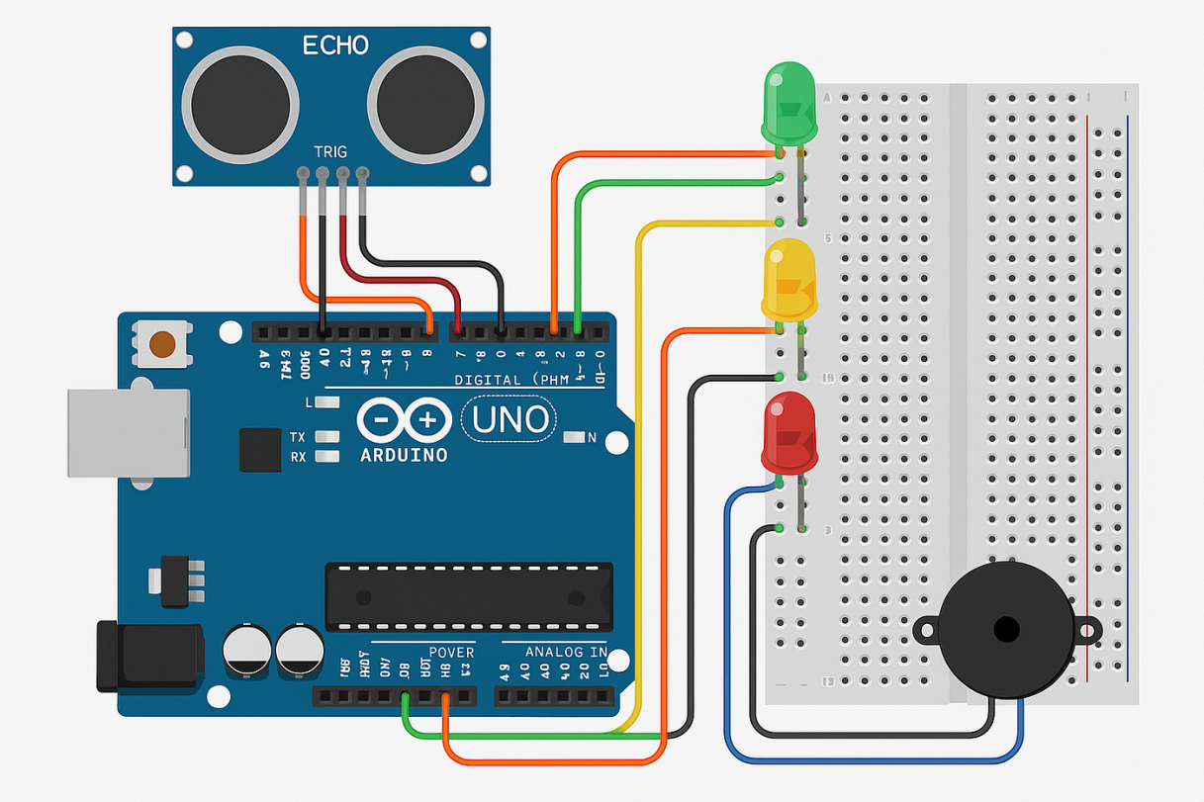
Circuit Connections
Key Pins
Ultrasonic: Trig → 9, Echo → 10
LEDs: Green → 2, Yellow → 3, Red → 4
Button → 7 (INPUT_PULLUP)
Buzzer → 8
LCD: RS=12, E=11, D4=5, D5=4, D6=3, D7=2

Slide 6
Working Principle or Flowchart
States:
Free → Green LED, “FREE” on LCD
Car Detected (<15 cm) → Buzzer beep, “Car Detected! Press to Start”
Confirmed (button press) → Red LED, timer starts, “Slot: OCCUPIED”
Time exceeded (>10s) → Yellow blink + buzzer pattern, “ALERT! TIME EXCEEDED!”
Checkout (button) → Reset to free
Flow: Measure distance → Detect? → Button? → Timer → Alert if over → Checkout

Slide 7
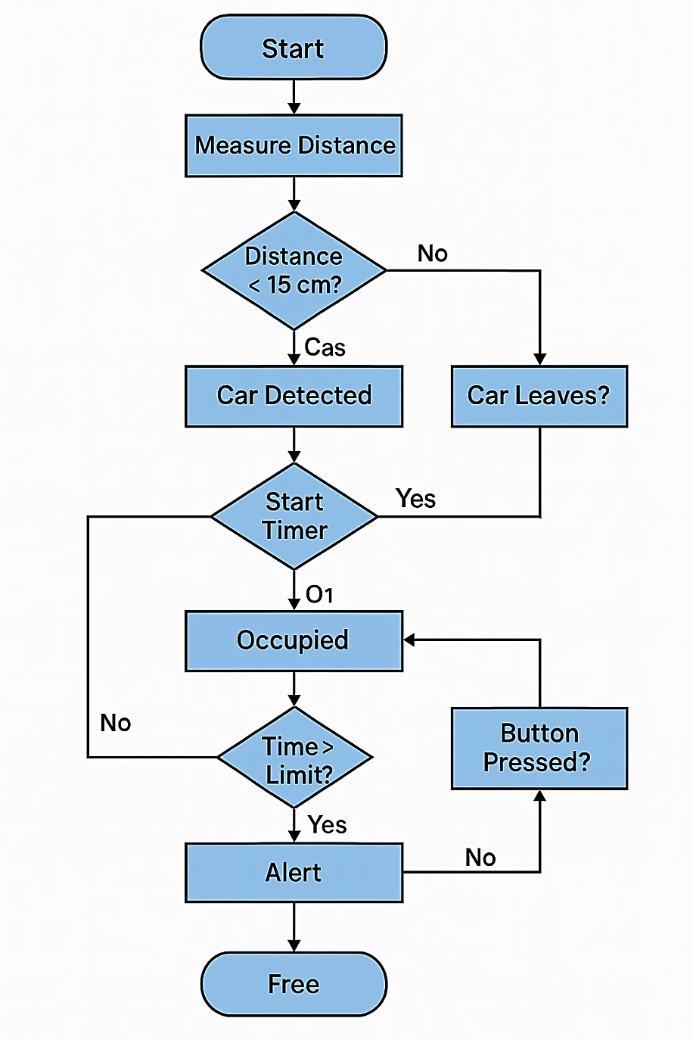
Working Principle or Flowchart

Slide 8
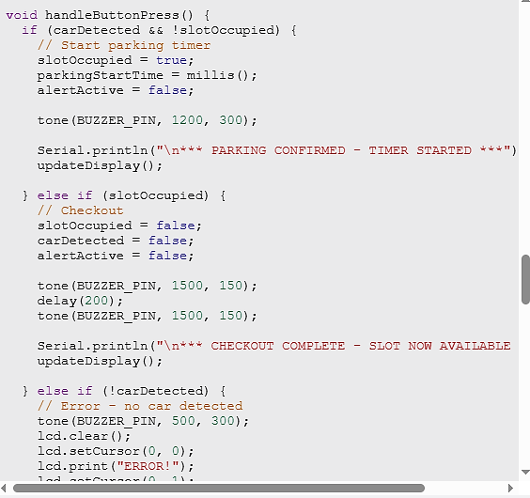
Key Code Features
Non-blocking with millis() for timer
Button debouncing
Separate flags: carDetected vs slotOccupied
Custom alert: blinkYellowLED() + buzzerAlertPattern()
Distance function with timeout
Full code available in submission

Slide 9

Demonstration
Tested States
Free: Distance 103.3 cm → “FREE ” (your screenshot)
Detected: <15 cm → “Press to Start”
Occupied: Timer running, red LED
Alert: After 10s → blinking + buzzer
Checkout: Back to free
Reliable detection, button prevents accidents, alerts noticeable

Slide 10
Demonstration

Slide 11
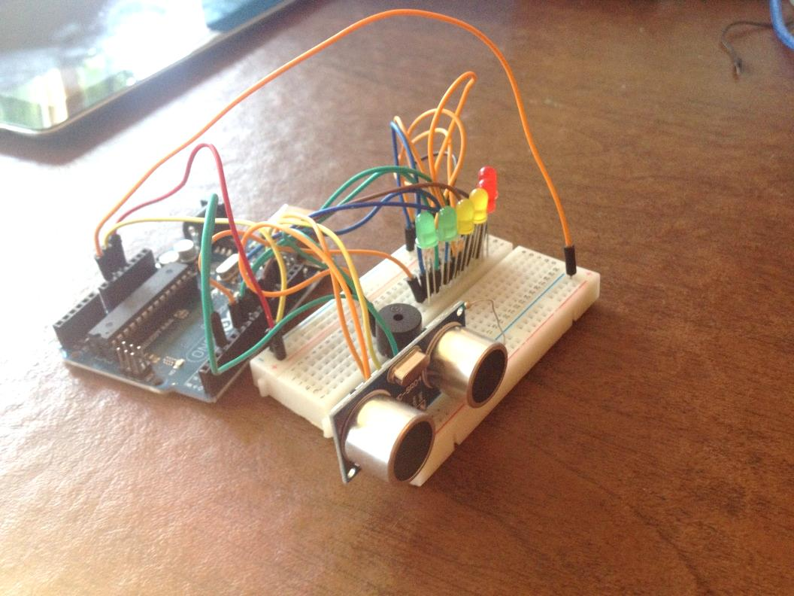
Conclusion
Successfully built a smart parking prototype with:
Auto-detection + user confirmation
Timed parking & overtime alert
Clear feedback (LCD, LEDs, buzzer)
Proves concept for real-world parking aids
Low-cost, easy to build and expand

Slide 12
Future Improvements
Multiple slots (add more sensors)
Servo gate for auto entry/exit
IoT: ESP8266/ESP32 + app notifications
Real timer (minutes/hours) + billing
Better sensors (IR/camera) for accuracy
Cloud logging like, ThingSpeak)

Slide 13
Q&A
Questions?
Thank you!

